Slide 1
C Programming

Slide 2

Eldiiar Dzhunusov
Junior Student
Love competitive programming
Computer Science Assistant

Slide 3
Why C is Important?

Slide 4
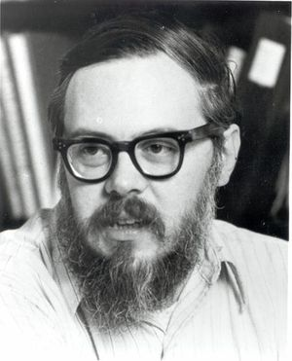
C History
C is a high-level programming language that was first developed by Dennis Ritchie at Bell Labs in the early 1970s.

Slide 5

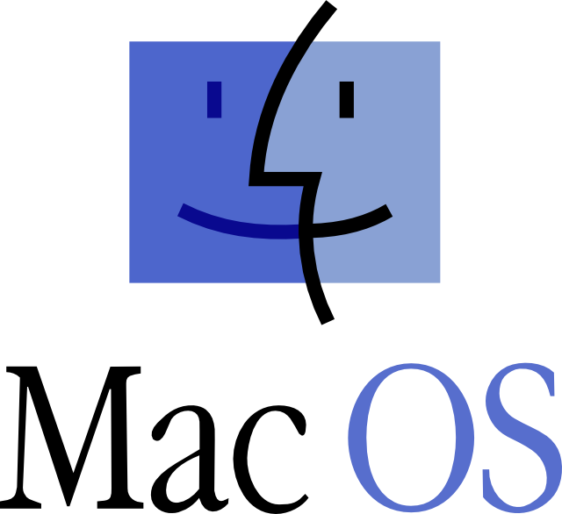
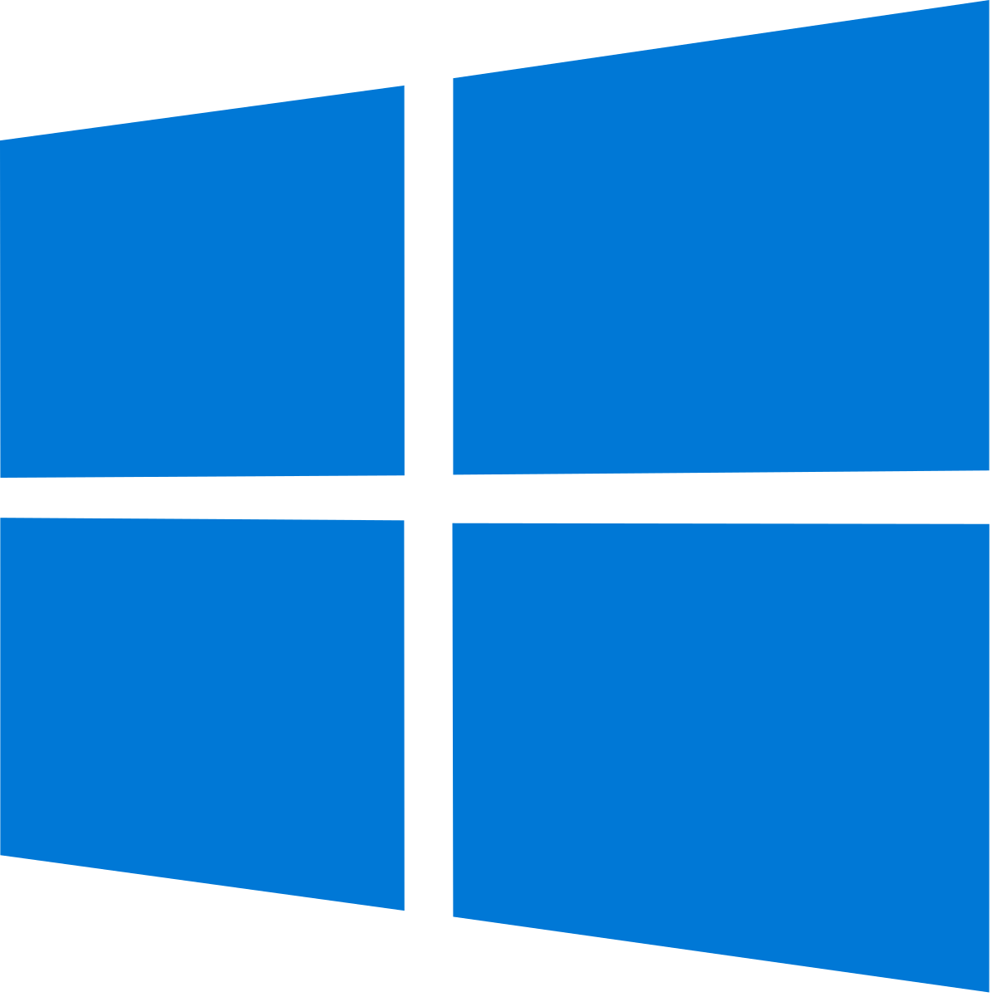


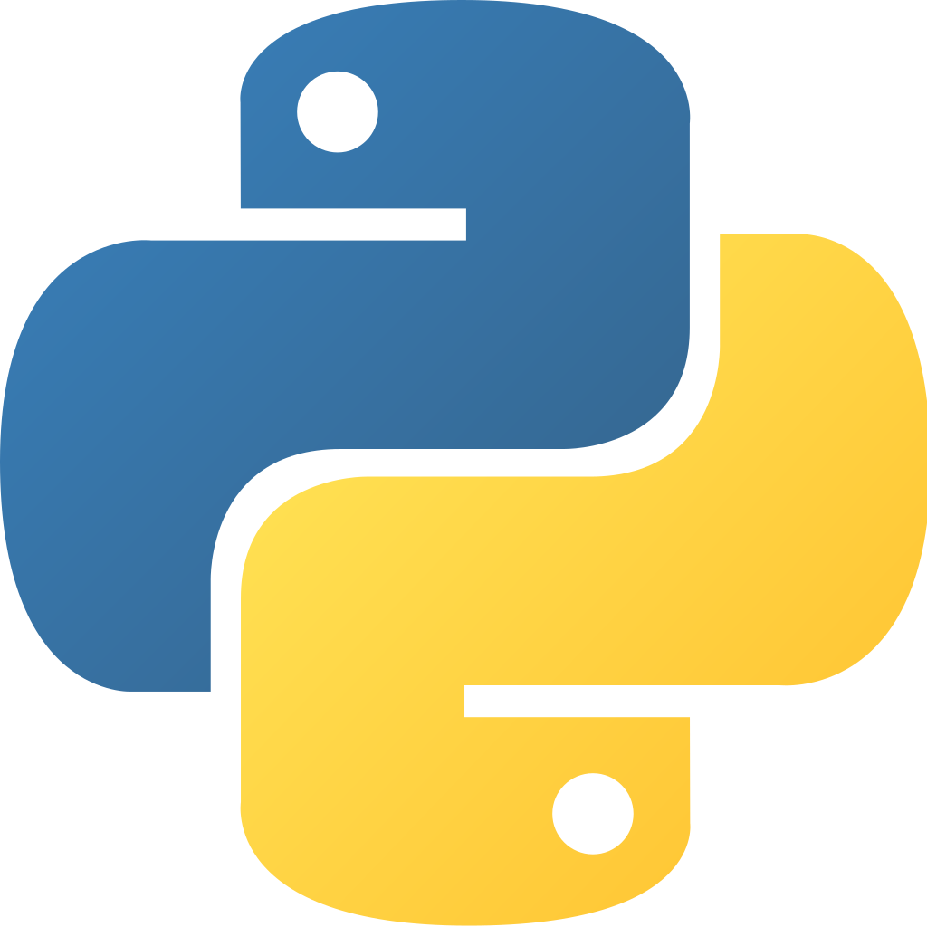
Unix was one of the first operating systems to be written in C. Microsoft Windows, Mac OS X, and GNU/Linux are also written in C. Lots of other high-level languages like Perl, PHP, Python, R, Matlab, Mathematica, etc., are written in C.

Slide 6
C-Family languages
C/C++
Objective–C
Perl
Java
PHP
C#
Go
Swift
Dart
Hack
And etc.

Slide 7
If you have any Questions
Just Ask

Slide 8
Let’s decide a date for meetings

Slide 9
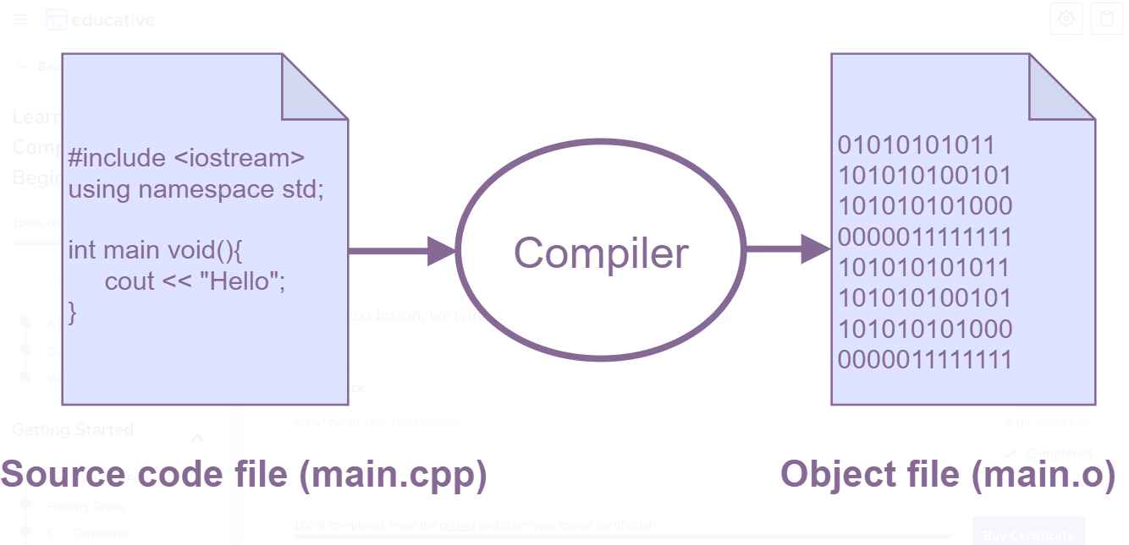
Compiler and Hello World!

Slide 10
Installation

